Slide 1
Classification of Haptik user queries into correct business Verticals
By Mudassir and Pramod

Slide 2
About Haptik
Haptik is India’s first Conversational Commerce platform that is powered by both AI and real humans and aim to redefine the way people get their everyday jobs done using chat as the underlying interface.
A combination of Artificial Intelligence, Natural Language Process & Machine Learning has helped Haptik create technology that assists their assistants work a lot faster; while the bot learns every time a new query is answered.

Slide 3
Problem Statement
A dataset containing user queries is provided. Each query is tagged by humans with single/multiple (all the applicable domains) domains. The task is to build a multi-label classifier using this training data. The classifier should tag all the possible domains for each query.
Classes: food, support(home services), reminders, movies, nearby, travel, recharge, casual, other
Evaluation Criteria:
There are two evaluation metric for this assignment
1: Classwise(k) precision and recall (True: class k is identified correctly)
2: Overall accuracy (True: All the classes are correctly identified for given record) (Baseline accuracy: 70%, expected accuracy > 80%)

Slide 4
Machine Learning
on Haptik Dataset

Slide 5
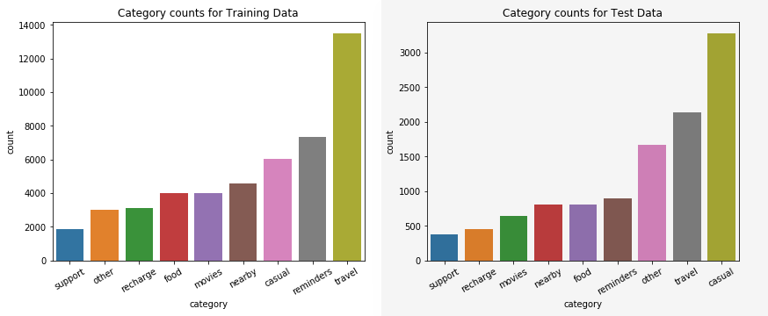
EDA Key Insights!
~40K rows in training dataset, 10K rows in testing dataset
Avg length of a message: 38 chars, 7 words
9 labels, 90% of observations have a single label
Class imbalances

Slide 6
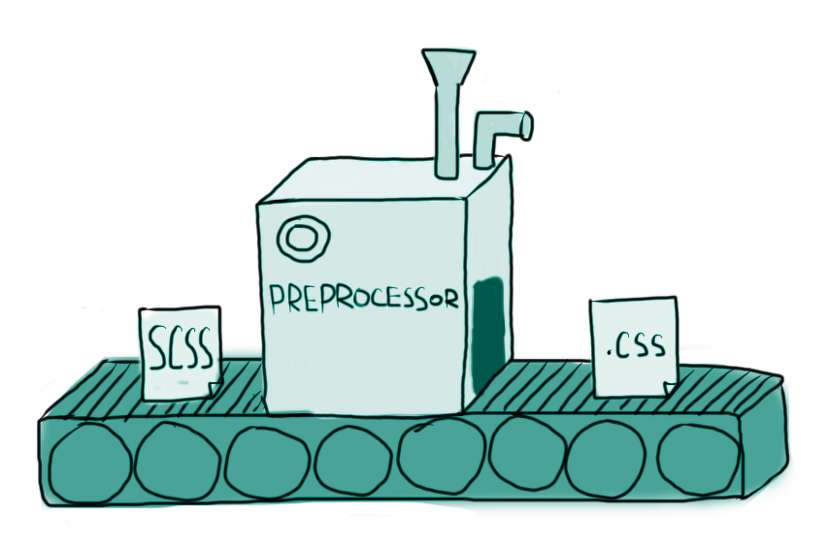
Preprocessing
Removal of punctuation
Removing system specific content
Removal of stopwords
Stemming
Returns a list of the cleaned tokens

Slide 7
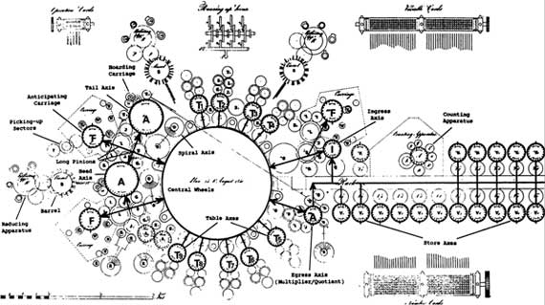
Feature Engineering
TimeofDay : replaced time data in the corpus (7am, 5pm etc) with a single token timeofday. It resulted in a total of 3468 tokens
DurationText: Replaced duration data in the corpus (15 min, 2hrs etc) with a single token ‘durationtext’
Phone number and PNR number : Replaced all 10 digit numbers with a token ‘phoneorpnr’. Increased ‘recharge’ recall.
Increased accuracy marginally by 0.2%

Slide 8
Classifier

Slide 9
First Approach
Used single label data
CountVectorizer + MultinomialNB
Used uni and bigrams
Accuracy : 80.13%
F-1 score : 80%

Slide 10
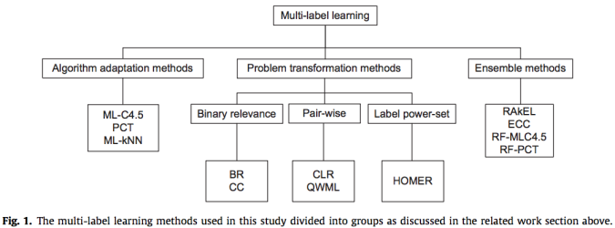
MultiLabel Approaches
Source : https://nickcdryan.wordpress.com/2017/01/23/multi-label-classification-a-guided-tour/

Slide 11
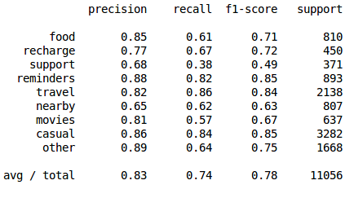
Binary Relevance
Trains n binary classifiers , one for each label
Aggregates all predictions to act as a multilabel classifier
Can work with any binary classifier
Implemented using OneVsRestClassifier sklearn with LinearSVC
Subset Accuracy : 73.95%

Slide 12
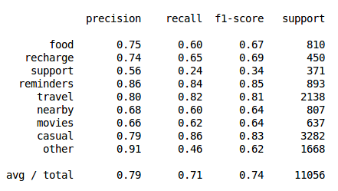
Random Forest
RandomForestClassifier in sklearn supports multilabel classification
Creates a multitude of decision trees and outputs the mode of the predicted classes
Subset Accuracy : 71.45%

Slide 13
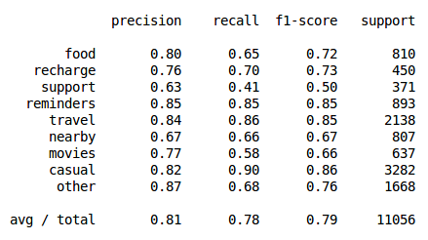
LabelPowerset
Each combination of labels becomes a single label
The problem is converted into multiclass
Can become complex (2^{L} labels)
Used LabelPowerset with LinearSVC
Subset Accuracy: 80.51%

Slide 14
Cross Validation
Stratified Cross-Validation
LabelPowerset to ensure distribution of combination of labels
Used 3 folds
Consistent accuracy across the folds

Slide 15
Further Work
Named Entity Recognition
Ensembling
Using better classification models
Improving individual labels
Spell check
Better labelling

Slide 16
Acknowledgement
Special thanks to:
Soumendra Dhanee
Jay Trivedi
Mayuresh Shilotri
Shweta Doshi

Slide 17


